Slide 1
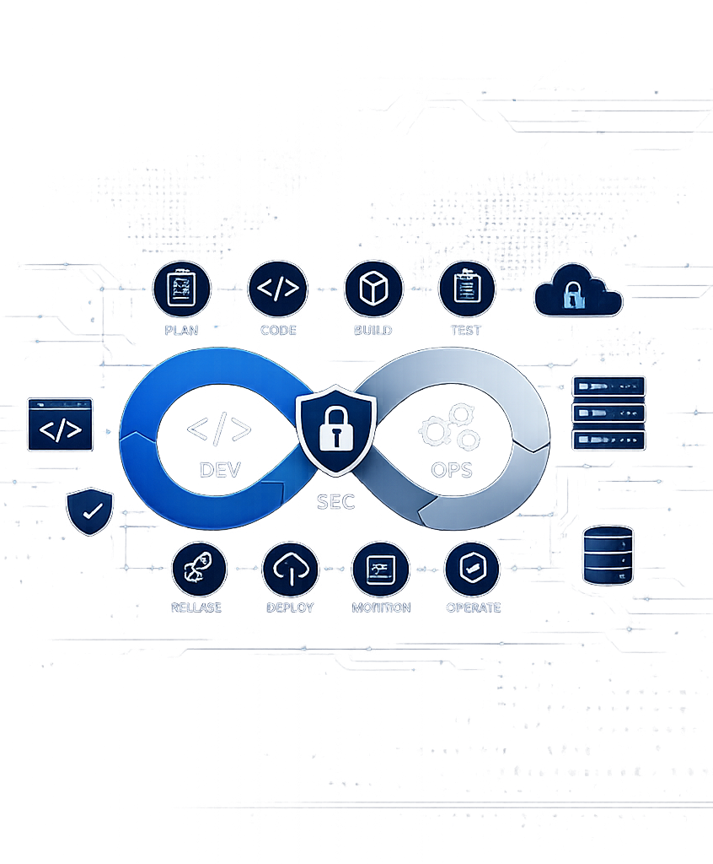
LECTURE 1
Introduction to
DevSecOps
AYESHA WIJESOORIYA

Slide 2
LECTURE OVERVIEW
Learning Outcomes
1
Explain why DevSecOps is required.
2
Describe the limitations of traditional software development.
3
Explain the relationship between DevOps and security.
4
Describe the key principles and goals of DevSecOps.
5
Explain how security is integrated throughout the Software Development Life Cycle (SDLC).
DevSecOps | 2

Slide 3
What is DevOps?

Slide 4
WARM-UP
Imagine This Scenario…
A software company develops an online banking application.
Discussion Question
Development
8 months
Could these security issues have been prevented if security had been considered earlier?
Testing
3 weeks
Security testing
Just before deployment
During the final security assessment, the team discovers:
• SQL Injection vulnerabilities
• Weak password storage
• Broken authentication
• Sensitive data exposure
The release is delayed by several weeks while developers fix these issues.
DevSecOps | 3
Notes:
Instead, ask the students:
"Imagine you're working as software engineers in a software company. Your team has spent 8 months developing an online banking system."
Then tell the story.
"Everything looks perfect. The client is happy. The developers have completed all the features. Testing is completed."
Pause.
"One week before deployment, the security team performs a penetration test."
Ask the class:
"What do you think happens next?"
Let students answer.
Then continue.
"The security team discovers SQL Injection, broken authentication, weak password storage, and sensitive data exposure."
Ask:
"Can we still release the software?"
Students will say No.
Then ask:
"So what should the developers do now?"
Expected answer:
Rewrite code
Fix vulnerabilities
Test again
Then explain:
"This means the project is delayed, costs increase, and the customer becomes unhappy."
Now ask your key question:
"Could these problems have been prevented if security had been considered from the beginning?"
Don't answer it yet.
Tell them:
"By the end of today's lecture, you'll know the answer."

Slide 5
MOTIVATION
Why Is Software Security Important?
Modern software stores and processes valuable information, including:
Personal information
A SECURITY BREACH MAY RESULT IN
Financial transactions
Financial losses
Medical records
Loss of customer trust
Business data
Government information
Legal penalties
Service disruption
Damage to an organization's reputation
DevSecOps | 4

Slide 6
CONTEXT
Today's Software Landscape
Modern software systems are:
Cloud-based
Web applications
Mobile applications
APIs
Microservices
Internet of Things (IoT)
AI-powered systems
As software becomes more connected, the number of potential attack surfaces increases.
DevSecOps | 5

Slide 7
FOUNDATIONS
Traditional Software Development
What is Software Development?
TYPICAL PHASES
Software development is the process of designing, building, testing, deploying, and maintaining software systems to satisfy user requirements.
01
Requirements Analysis
02
System Design
03
Development
04
Testing
05
Deployment
06
Maintenance
DevSecOps | 6

Slide 8
FOUNDATIONS
Traditional Software Development Life Cycle
1
›
2
›
3
›
4
›
5
›
6
Requirements
Design
Development
Testing
Deployment
Maintenance
Each phase completes before the next begins security is typically addressed only at the end, just before deployment.
DevSecOps | 7

Slide 9
FOUNDATIONS
Characteristics of Traditional Development
Sequential process
Teams work independently
Manual testing
Security checked near the end
Long development cycles
Slow customer feedback
DevSecOps | 8

Slide 10
FOUNDATIONS
Team Structure in Traditional Development
Development Team
↓
Testing Team
↓
Operations Team
↓
Security Team
Each team works independently, often with limited communication.
DevSecOps | 9

Slide 11
DISCUSSION
Security Challenges in
Traditional Development?
DevSecOps | 10

Slide 12
PART TWO
Introduction to DevOps
What is DevOps?
DevOps is a culture, set of practices, and collection of tools that enable collaboration between Development and Operations teams to deliver software faster and more reliably.
DEV
+
OPS
Collaboration across the software delivery lifecycle
DevSecOps | 11

Slide 13
PART TWO
Objectives of DevOps
01
02
03
Faster software delivery
Continuous Integration (CI)
Continuous Delivery (CD)
04
05
06
Automation
Collaboration
Continuous Monitoring
07
Higher software quality
DevSecOps | 12

Slide 14
PART TWO
DevOps Lifecycle
Plan
Monitor
Code
Continuous
Loop
Operate
Build
Deploy
Test
Release
DevSecOps | 13

Slide 15
PART TWO
Benefits of DevOps
Faster releases
Reduced deployment failures
Improved collaboration
Automated processes
Continuous feedback
Improved software quality
DevSecOps | 14

Slide 16
TURNING POINT
Is DevOps Enough?
DevOps improves speed and collaboration.
However, security is often treated as a separate activity.
This is exactly the gap DevSecOps is designed to close.
QUESTION
Can fast software still be insecure?
Yes.
DevSecOps | 15

Slide 17
COMING UP NEXT
Introduction to
DevSecOps
Bringing security into every stage of the software delivery lifecycle.

Slide 18
PART THREE
Introduction to
DevSecOps
Integrating security into every stage of the Software Development Life Cycle.

Slide 19
PART THREE
What is DevSecOps?
DevSecOps is the practice of integrating security into every stage of the Software Development Life Cycle (SDLC). It combines Development, Security, and Operations into one collaborative process.
DEV
+
SEC
+
OPS
Security integrated across Development and Operations
DevSecOps | 18

Slide 20
PART THREE
DevOps vs DevSecOps
DevOps
DevSecOps
Focuses on speed
Focuses on speed and security
Security often added later
Security integrated throughout
Developers + Operations
Developers + Security + Operations
Limited security automation
Continuous automated security
DevSecOps | 19

Slide 21
PART THREE
Shift Left Security
Traditional
DevSecOps
Development
Security
↓
↓
Testing
Development
↓
↓
Security
Testing
↓
Deployment
Security begins from the earliest stages of development.
DevSecOps | 20

Slide 22
PRINCIPLES
Principle 1 – Security as a Shared Responsibility
Security is everyone's responsibility.
Developers
Testers
Operations Engineers
Security Engineers
Project Managers
DevSecOps | 21

Slide 23
PRINCIPLES
Principle 2 – Automation
Automate repetitive security tasks such as:
Code scanning
Dependency checking
Vulnerability scanning
Compliance verification
DevSecOps | 22

Slide 24
PRINCIPLES
Principle 3 – Continuous Security
1
›
2
›
3
›
4
›
5
Coding
Building
Testing
Deployment
Monitoring
Security should be continuously applied throughout the lifecycle.
DevSecOps | 23

Slide 25
PRINCIPLES
Principle 4 – Continuous Monitoring
Organizations should continuously monitor:
System logs
User activity
Security events
Network traffic
Threats
DevSecOps | 24

Slide 26
PART THREE
Goals of DevSecOps
01
02
03
Deliver secure software
Detect vulnerabilities early
Reduce development costs
04
05
06
Improve collaboration
Increase automation
Achieve compliance
07
Build customer trust
DevSecOps | 25

Slide 27
APPLICATION
Integration of Security into the SDLC
SDLC Phase
Security Activity
Requirements
Security Requirements
Design
Threat Modeling
Development
Secure Coding
Build
Dependency Scanning
Testing
Security Testing
Deployment
Infrastructure Security
Operations
Continuous Monitoring
DevSecOps | 26

Slide 28
APPLICATION
Example: Online Shopping System
Requirements
Development
Testing
Deployment
Operations
User authentication
Secure payment gateway
Input validation
Password hashing
Vulnerability scanning
Penetration testing
Secure cloud configuration
Monitor login attempts
Patch vulnerabilities
DevSecOps | 27

Slide 29
SUMMARY
Key Takeaways
✓
Traditional software development introduces security too late.
✓
DevOps improves collaboration and software delivery.
✓
DevSecOps integrates security into every stage of development.
✓
Security becomes a shared responsibility.
✓
Automation enables faster and more secure software delivery.
DevSecOps | 28

Slide 30
DISCUSSION
Think–Pair–Share Activity
A hospital develops a patient management system.
DISCUSSION QUESTIONS
Currently, security testing is performed only after the application has been completed.
What risks could arise from delaying security testing?
Discuss in small groups:
How would DevSecOps change this process?
• What risks could arise from this approach?
• How would DevSecOps improve the development process?
Which phases need security built in?
• Which SDLC phases should include security activities?
Be prepared to share your group's ideas with the class.
DevSecOps | 29

Slide 31
WRAP-UP
Q & A
Questions and open discussion.

